Slide 1
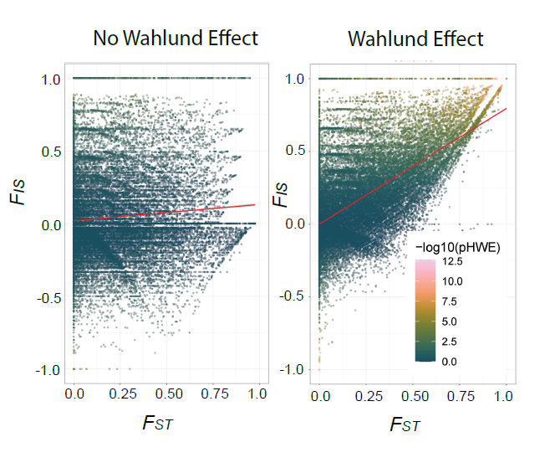
Testing for Hardy-Weinberg Proportions: Theory and Filtering
William Hemstrom
ConGen 2023
August 29th, 2023

Slide 2
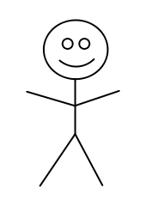
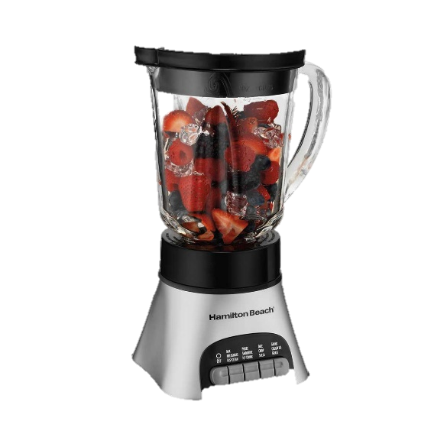
HWE
AA
Bag o’ Alleles
A
G
AG
G
A
A
G
A
A
AA
GG

Slide 3
HWE
Bag o’ Alleles
A
G
G
A
A
G
A
A
x1000
Totals:
450 As
550 Gs
Frequencies:
A: .45
G: .55

Slide 4
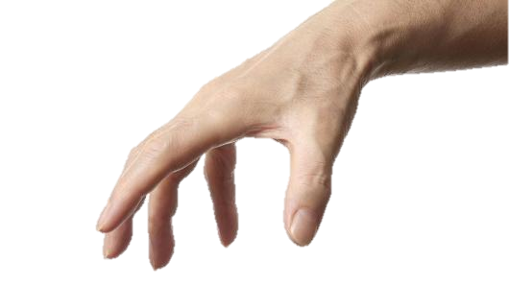
Bag o’ Alleles
A
G
G
A
A
G
A
A
Totals:
450 As
550 Gs
Frequencies:
A: .45
G: .55

Slide 5

Bag o’ Alleles
A
G
A
G
A
A
G
A
A
A
Frequencies:
A: .45
G: .55
.45 * .45 = 0.2025

Slide 6
Bag o’ Alleles
A
G
G
G
A
A
G
A
A
G
Frequencies:
A: .45
G: .55
.55 * .55 = 0.325

Slide 7
Bag o’ Alleles
A
G
G
A
G
A
G
A
A
A
Frequencies:
A: .45
G: .55
.45 * .55 = 0.2475

Slide 8
Bag o’ Alleles
A
G
A
G
A
A
G
A
A
G
Frequencies:
A: .45
G: .55
.55 * .45 = 0.2475

Slide 9
A then A
.45 * .45 = 0.2025
q²
G then G
.55 * .55 = 0.3250
p²
G then A
.55 * .45 = 0.2475
pq
2pq
A then G
.45 * .55 = 0.2475
qp
p² + 2pq + q² = 1

Slide 10
Filtering?
Bag o’ Alleles
A
G
G
A
A
G
A
A
Anything that causes allele draw probabilities to be dependent on each other will cause a deviation from HWE:
Selection (GGs are lethal)
Migration (a bunch of GGs enter or leave the population)
Drift (randomly lost most of our GGs)
Paralogy (all individuals are actually AA and GG, so look AG)
Sequencing or genotyping errors (the G allele doesn’t sequence well if there is also an A allele).
Etc…

Slide 11
Filtering?
Bag o’ Alleles
A
G
G
A
A
G
A
A
Anything that causes allele draw probabilities to be dependent on each other will cause a deviation from HWE:
Selection (GGs are lethal)
Migration (a bunch of GGs enter or leave the population)
Drift (randomly lost most of our GGs)
Paralogy (all individuals are actually AA and GG, so look AG)
Sequencing or genotyping errors (the G allele doesn’t sequence well if there is also an A allele).
Etc…

Slide 12
Filtering?
Bag o’ Alleles
A
G
G
A
A
G
A
A
Anything that causes allele draw probabilities to be dependent on each other will cause a deviation from HWE:
Selection (GGs are lethal)
Migration (a bunch of GGs enter or leave the population)
Drift (randomly lost most of our GGs)
Paralogy (all individuals are actually AA and GG, so look AG)
Sequencing or genotyping errors (the G allele doesn’t sequence well if there is also an A allele).
Etc…

Slide 13
Testing for HWE – Filtering
Anything that causes allele draw probabilities to be dependent on each other will cause a deviation from HWE:
Selection (GGs are lethal)
Migration (a bunch of GGs enter or leave the population)
Drift (randomly lost most of our GGs)
Paralogy (all individuals are actually AA and GG, so look AG)
Sequencing or genotyping errors (the G allele doesn’t sequence well if there is also an A allele).
Etc…

Slide 14
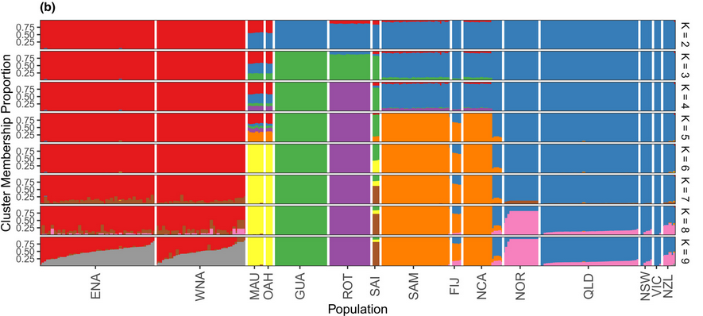
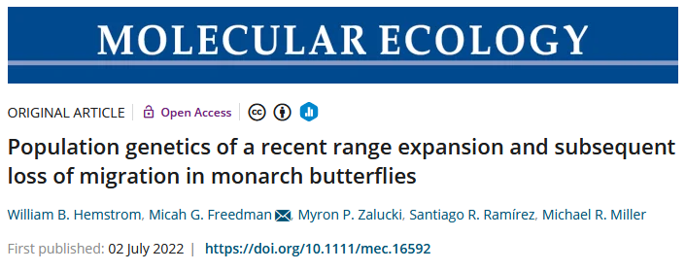
Testing for HWE – Filtering
Many methods assume HWE!
For example: STRUCTURE!
Sequencing errors can cause deviations!
Allelic dropout (G less likely to sequence when we sequence and A)
Solution: Filter (remove) loci not in HWE
However, filtering inappropriately can also cause problems!

Slide 15
Filtering: Wahlund effects
HWE Filtering options:
Within each population
Global
Guam
Rota

Slide 16
Filtering: Wahlund effects
Global:
Guam
Rota
f(G): 0.5
f(G): 0.9
f(A): 0.5
f(G): 0.1
f(A): 0.1
f(A): 0.9
f_{e}(AG): 0.18
f_{e}(AG): 0.18
f_{e}(AG): 0.5

Slide 17
Filtering: Wahlund effects
Wahlund effect
Population structure amplifies HWE deviations in the most differentiated loci.
Global is often the default but can skew results!
Hemstrom et al. in review

Slide 18
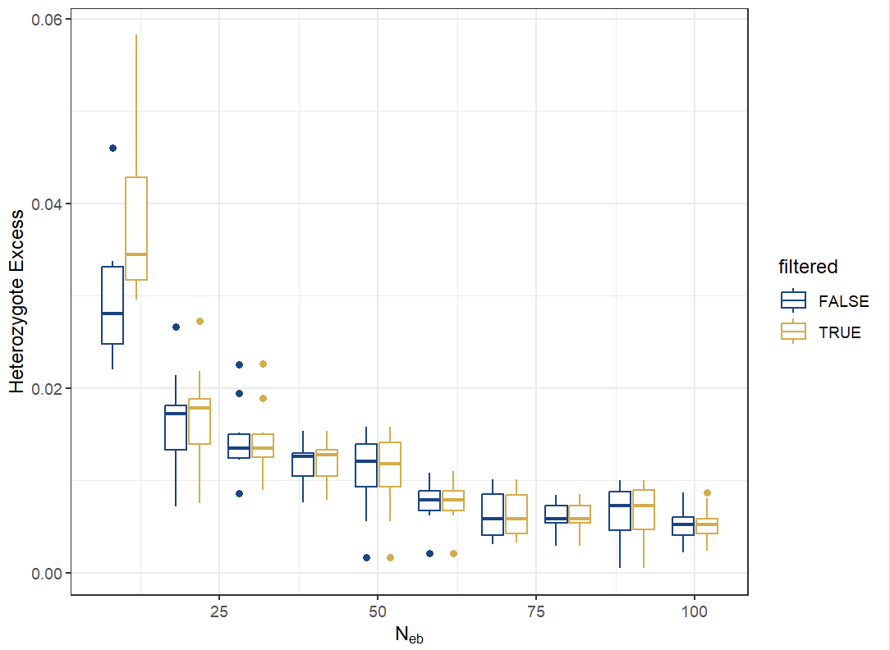
Filtering: Effective Size
Low N_{E} causes heterozygote excess.
Filtering loci out of HWE can change inferences.

Slide 19
Filtering: Selection detection
Anything that causes allele draw probabilities to be dependent on each other will cause a deviation from HWE:
Selection
Heterozygote advantage
More AGs than expected.
Heterozygote disadvantage
Less AGs than expected.
Directional
Less AAs OR GGs (and maybe AGs?) than expected, depending on dominance.

Slide 20
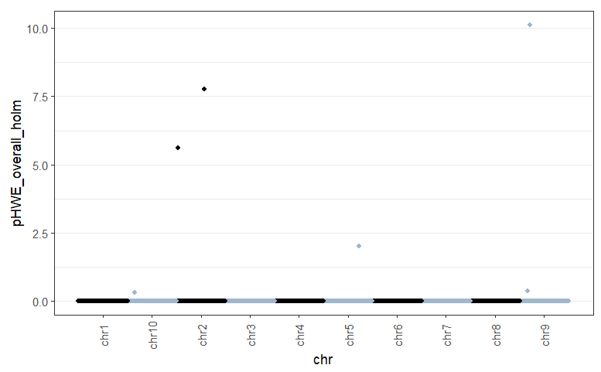
Filtering: Selection detection
Selection
Selection
Anything that causes allele draw probabilities to be dependent on each other will cause a deviation from HWE:
Selection
Heterozygote advantage
More AGs than expected
p = 0.001

Slide 21
Testing for HWE – Filtering
HWE filtering can be critical for some downstream tasks
HWE filtering can catch sequencing errors and/or paralogy
HOWEVER…
HWE filtering can remove sites with interesting biological effects
Solution? Don’t just try one filtering set.

Slide 22
Hemstrom et al. in review

Slide 23
Testing for HWE – χ² test
Genotype | Observed | Expected
AA
AG
GG

Slide 24
Testing for HWE – χ² test
Genotype | Observed | Expected
AA | 35
AG | 110
GG | 35

Slide 25
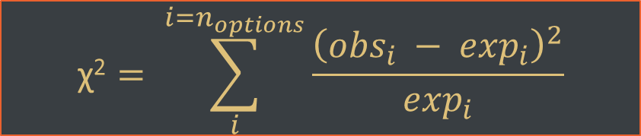
Testing for HWE – χ² test
Genotype | Observed | Expected
AA | 35 | 45
AG | 110 | 90
GG | 35 | 45
$$\text{χ}\text{2}= \sum_{i}^{i=n_{options}}{\frac{{\left({obs}_{i} − \exp_{i}\right)}^{2}}{\exp_{i}}}$$

Slide 26
Testing for HWE – χ² test
Genotype | Observed | Expected | χ²
AA | 35 | 45 | 2.22
AG | 110 | 90 | 4.44
GG | 35 | 45 | 2.22
$$\text{χ}\text{2}= \sum_{i}^{i=n_{options}}{\frac{{\left({obs}_{i} − \exp_{i}\right)}^{2}}{\exp_{i}}}$$

Slide 27
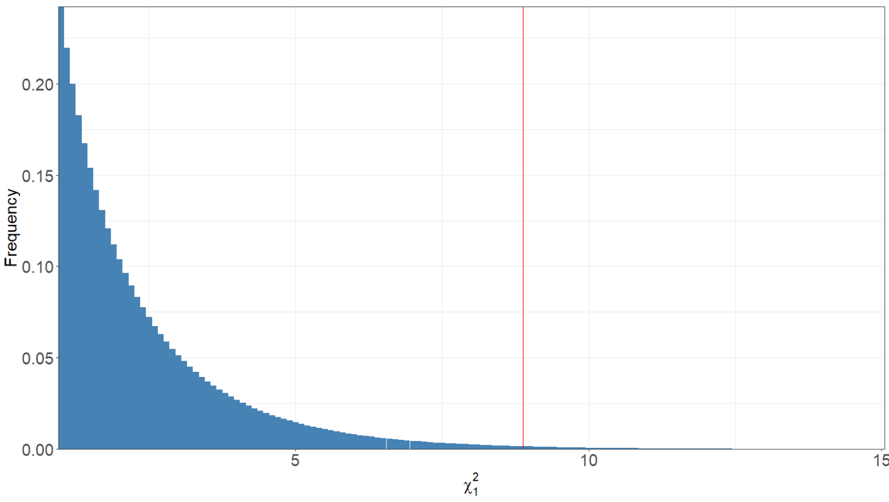
Testing for HWE – χ² test
Genotype | Observed | Expected | χ²
AA | 35 | 45 | 2.22
AG | 110 | 90 | 4.44
GG | 35 | 45 | 2.22
χ² = 8.88
p = 0.002
Compare to a null distribution.
Created by assuming we are randomly sampling from a population in HWE and calculating χ² an infinite number of times!

Slide 28
Testing for HWE – Fisher’s Exact Test
Compare to a null distribution.
How likely is it that we would have observed a sample more out of HWE than ours out of all the possible sampling outcomes with our sample size?
Genotype | Observed | Expected
AA | 34 (-1) | 45
AG | 111 (+1) | 90
GG | 35 | 45
Genotype | Observed | Expected
AA | 35 | 45
AG | 110 | 90
GG | 35 | 45
Genotype | Observed | Expected
AA | 33 (-2) | 45
AG | 112 (+2) | 90
GG | 35 | 45

Slide 29
Testing for HWE – Fisher’s Exact Test
Genotype | Observed | Expected
AA | 34 (-1) | 45
AG | 111 (+1) | 90
GG | 35 | 45
Genotype | Observed | Expected
AA | 35 | 45
AG | 110 | 90
GG | 35 | 45
For each combination of values, calculate probability of observing that exact state under H₀
p-value is the total probability of all as or more out-of-HWE combinations.
p = 0.004
Genotype | Observed | Expected
AA | 33 (-2) | 45
AG | 112 (+2) | 90
GG | 35 | 45
Genotype | Observed | Expected
AA | 90 | 45
AG | 0 | 90
GG | 90 | 45
Genotype | Observed | Expected
AA | 32 (-3) | 45
AG | 113 (+3) | 90
GG | 35 | 45
Genotype | Observed | Expected
AA | 35 | 45
AG | 111 (+1) | 90
GG | 35 34 (-1) | 45

